Slide 1


"Women in Mining Cooperatives in Rural Rwanda"
Original Research Paper Presentation
“Resource Conflicts” Session
64th African Studies Association Meeting
November 18, 2021
Dr. Laine Munir (PI)
Global Challenges Program, African Leadership University
Center of Excellence in Biodiversity, University of Rwanda
2021 Harry Frank Guggenheim Distinguished Scholar

Slide 2
Project Overview
1
RQ:
Could cooperative business models mitigate some of the
negative impacts on women of private mining operations?
Case study themes:
Economic security: Incomes & financial outcomes for women
Physical security: Gender-based violence (GBV)
Legal/governance security: legal awareness & conflict resolution conduits
Locations in 2021: Six rural districts in all five provinces of Rwanda

Slide 3
Literature
2
The “resource curse” in Africa
Rwanda’s breakneck rise in mineral extraction and export
Rwanda’s state formalization of the economy, including ASMs
Widespread support for cooperatives as a business model
The Good: cooperatives may be compatible with African values, provide state-like provisions for the vulnerable, be democratic, anti-corporate, and “women-friendly”
The Bad: cooperatives may be neocolonial, overly political, and reify inequality with a façade of equality

Slide 4
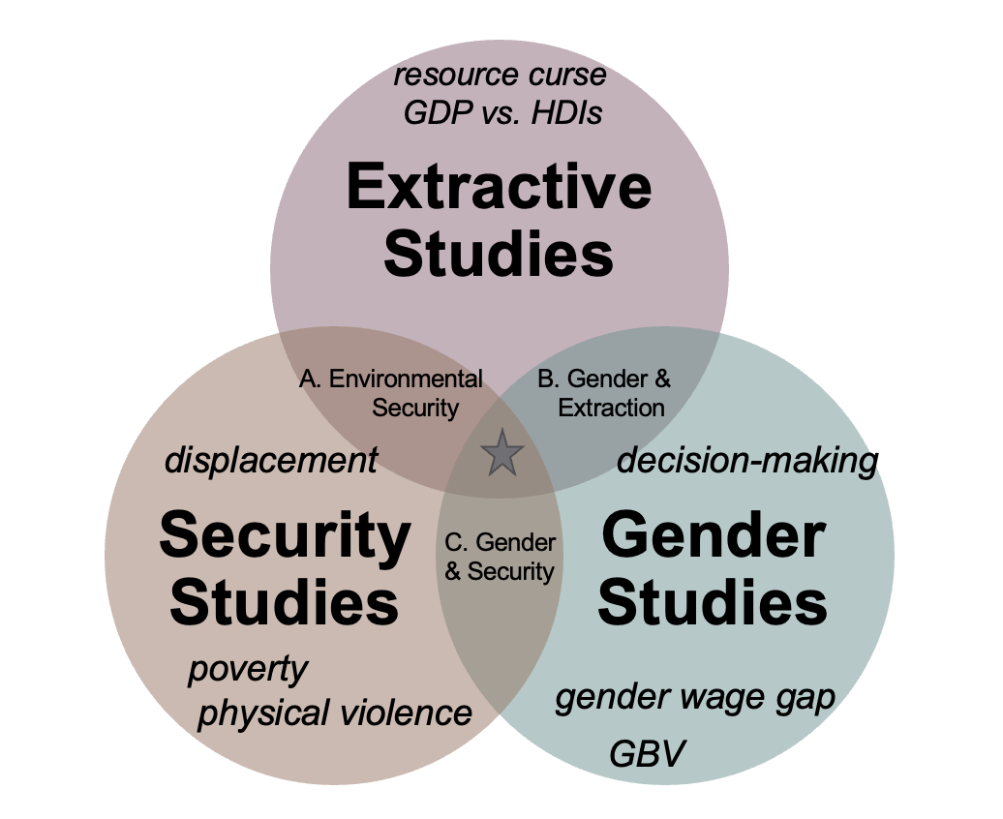
Literature
2

Slide 5
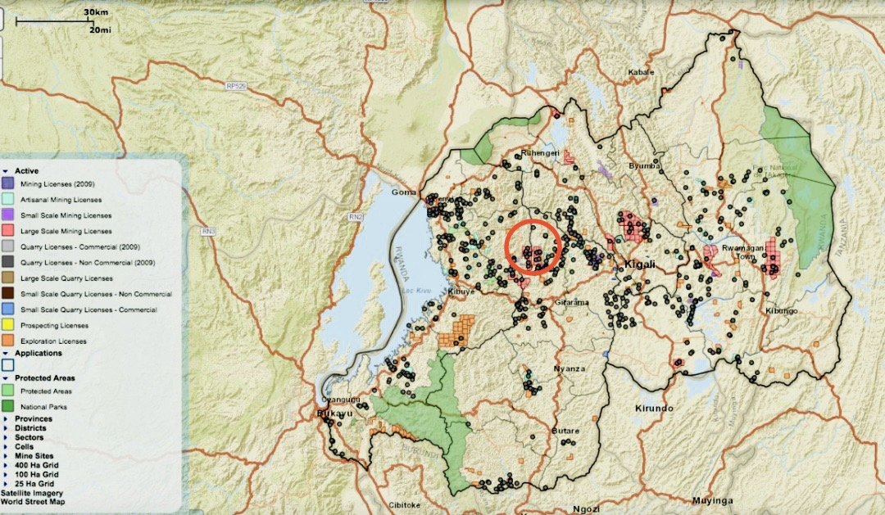
Methods
3
CASE: COMIKAGI, Rwanda’s largest mining cooperative
DATA: 1. 60 one-on-one, semi-structured interviews
2. 12 FGDs (10 participants each)
3. 14 days of observations
4. Social maps: 6 collective & 60 individual hand-drawn maps

Slide 6
Methods
3
MODE OF ANALYSIS:
Conceptual (or thematic?) content analysis in NVivo with three themes of financial, GBV, and legal outcomes.
Determined the level of analysis to be two-fold: word sense and phrase. Determined to code for the three pre-defined concepts to stay focused on the specific research question.
Determined to code for the frequency of codes within these three concepts.
Determined coding rules for when text appears in different forms; coded text in NVivo
Analyzed results in NVivo by counting code frequencies and then “deep diving”; using program-specific visualization tools.
Notes:
This allowed for flexibility in the interpretation and translation between Kinyarwanda and English.
permitting a relatively wide berth for the text's implication. This is equivalent to validity.

Slide 7
Findings
4
Women report their lives are better with mining than they would be without it.
Little to no evidence that the cooperative increases women’s incomes more than private company employment.
Little to no evidence that the cooperative reduces women’s experiences with GBV; reported rates of transactional sex were higher in the cooperative than other communities.
Ample evidence that women who work for the cooperative understand the larger legal and economic system, know pathways for their grievances, and expect just outcomes.

Slide 8
Relevance & Conclusion
5
We must avoid the “feel good” idea that cooperatives are necessarily beneficial for women.
Formalization and legalization of economies must be part-and-parcel of gender equality policies and programming at the local level.
There may be “aspirational” and indirect benefits of cooperatives on women’s sense of legal consciousness and fair governance.

Slide 9
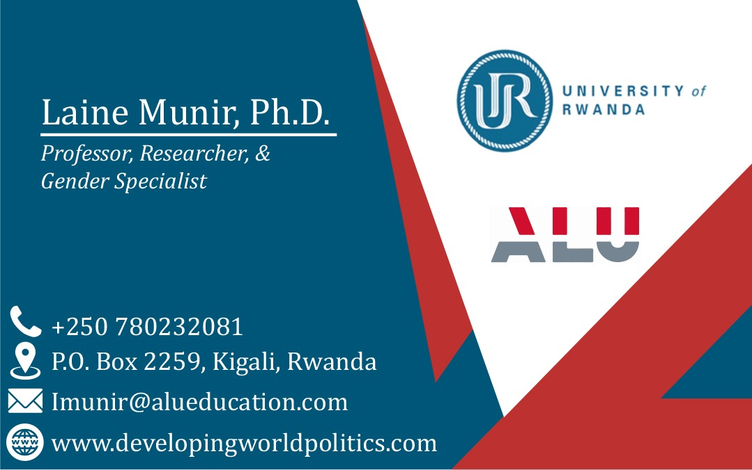
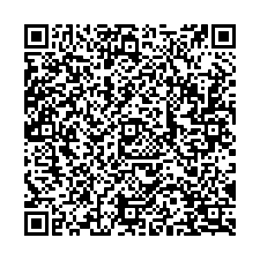
Thank You
6
Many thanks to the generosity of the Harry Frank Guggenheim Foundation for funding this research.

